Slide 1
أحمد محمد حمدى الجبالى
scikit learn

Slide 2
Random Forest Classifier

Slide 3
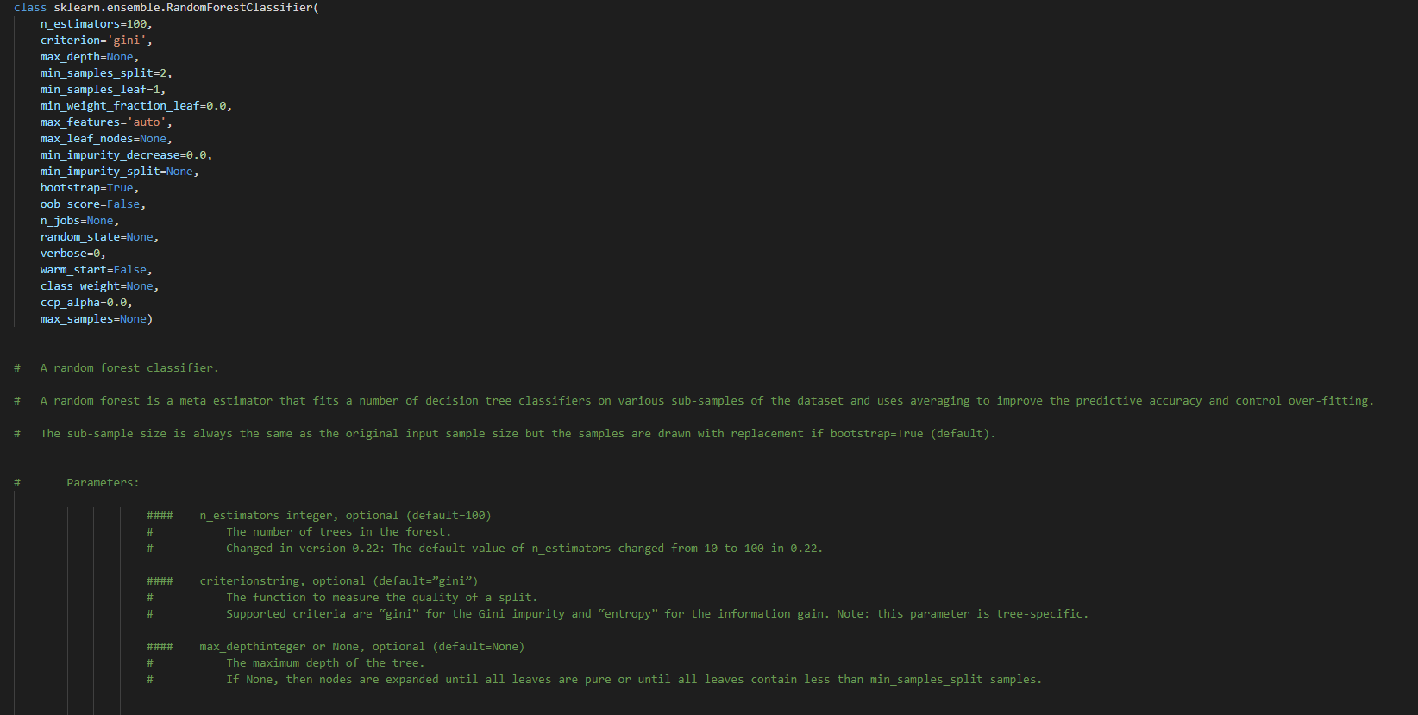

Slide 4
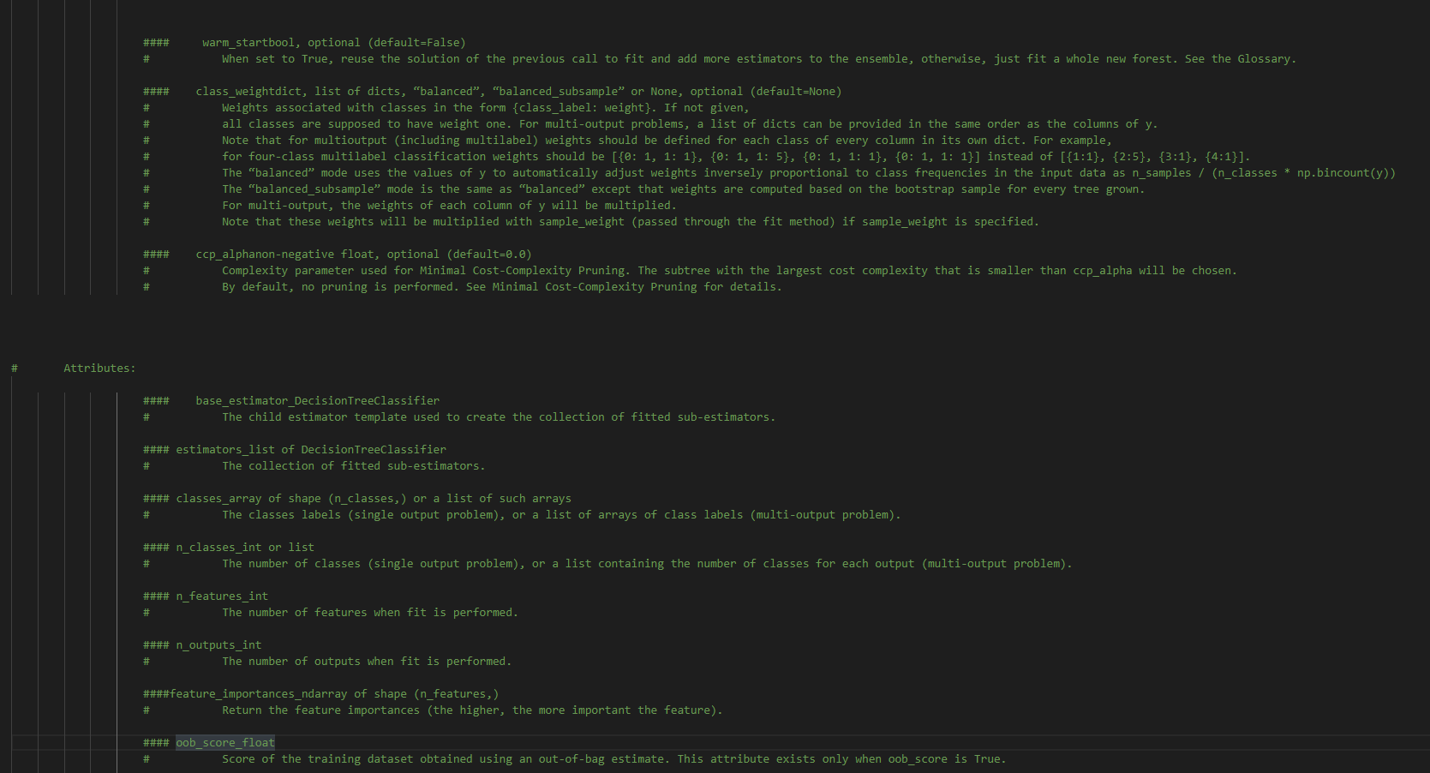

Slide 5
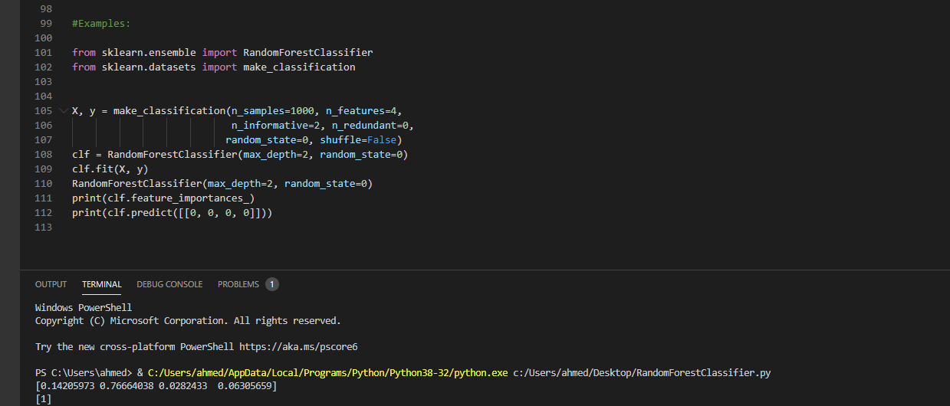

Slide 6
Neural network models

Slide 7
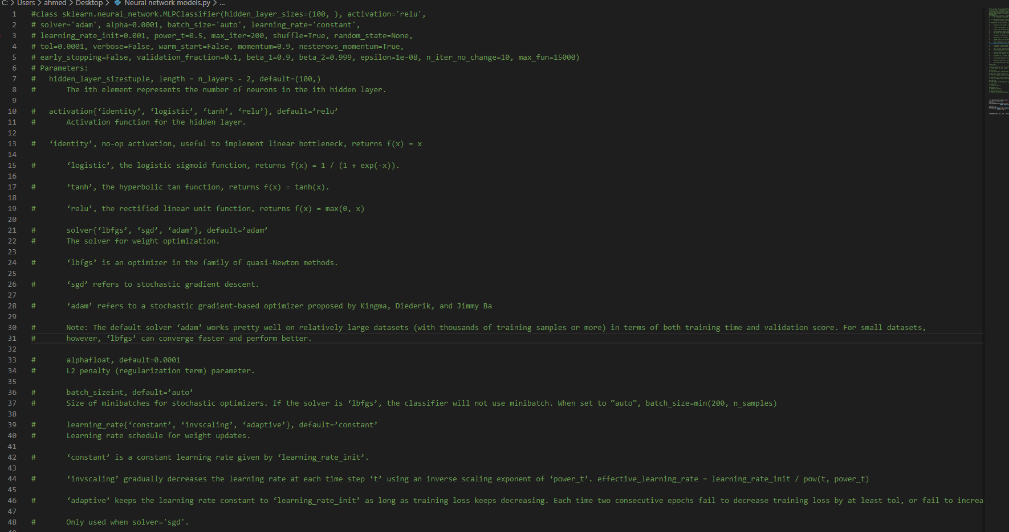

Slide 8
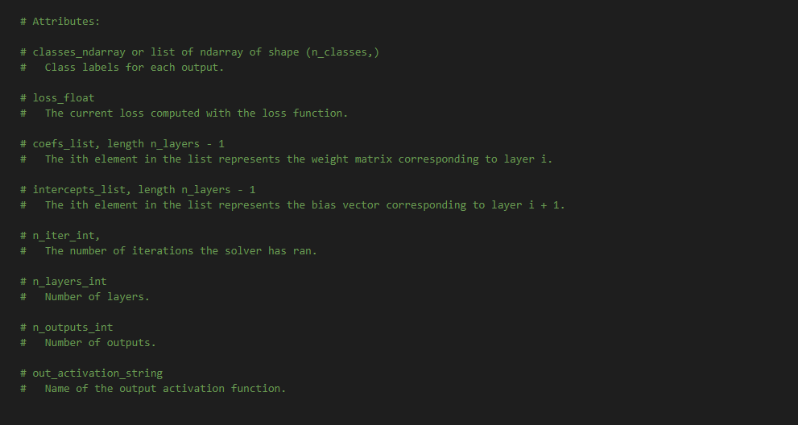

Slide 9
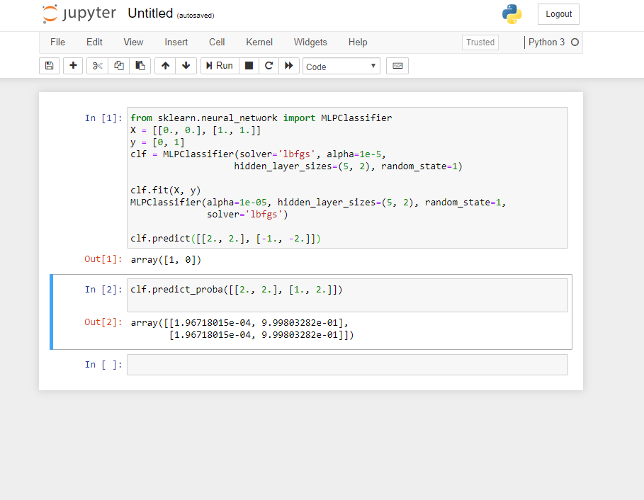

Slide 10
Support Vector Machines

Slide 11
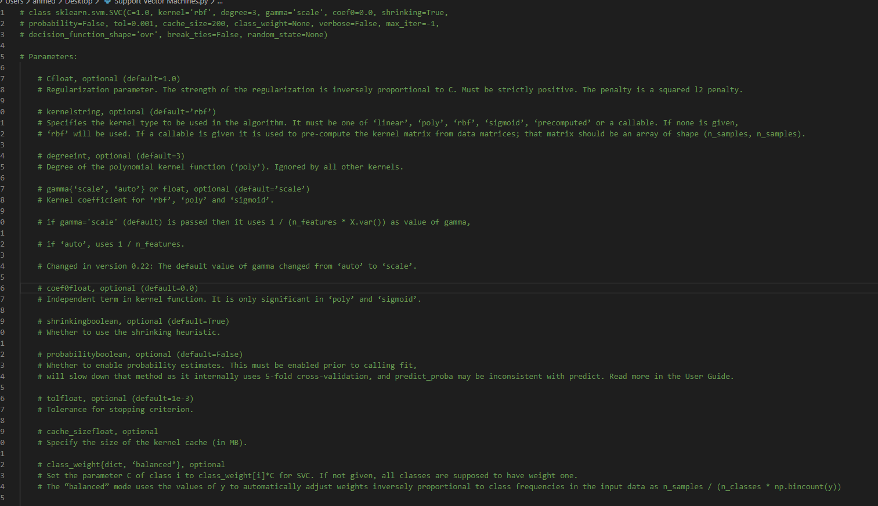

Slide 12
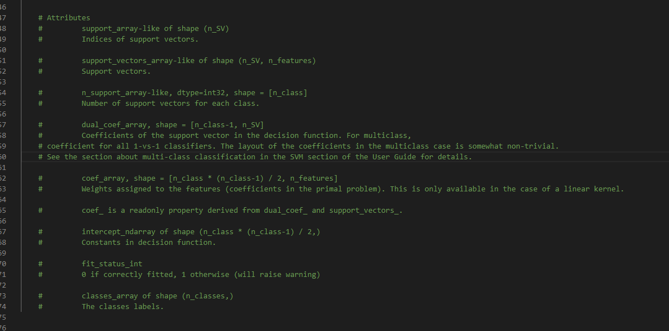

Slide 13
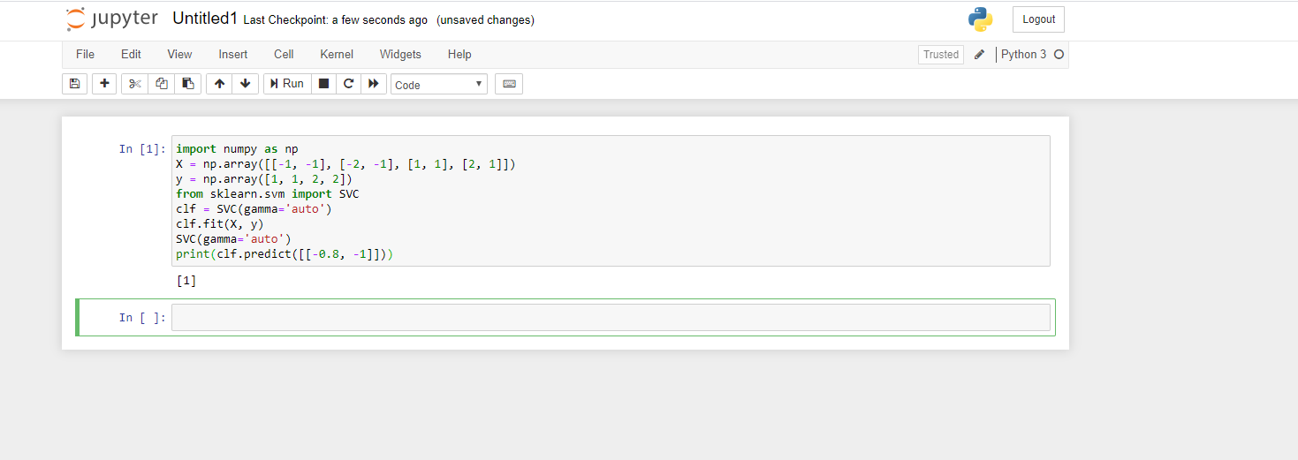

Slide 14
Decision Trees

Slide 15
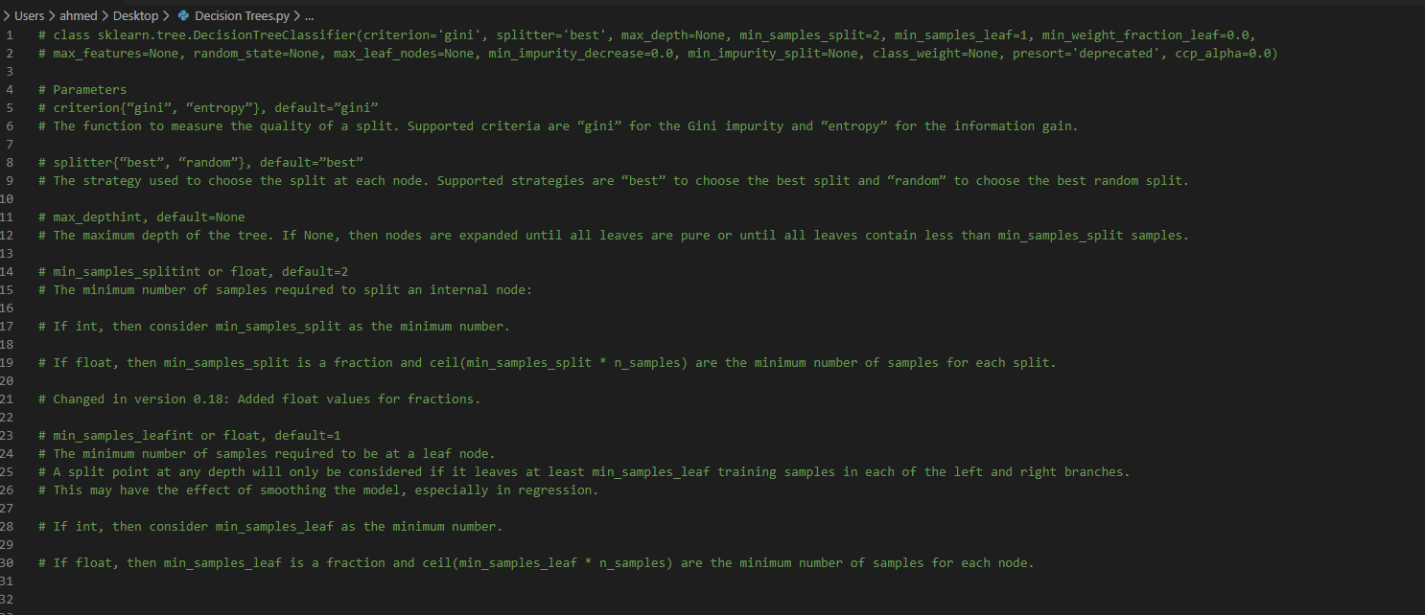

Slide 16


Slide 17
